Slide 1
PnP Community Call – December 2014
aka.ms/OfficeDevPnP
aka.ms/OfficeDevPnPYammer
PnP Core Team

Slide 2




Agenda
Month highlights
Contributions and process
Other topics
Roadmap and next steps

Slide 3
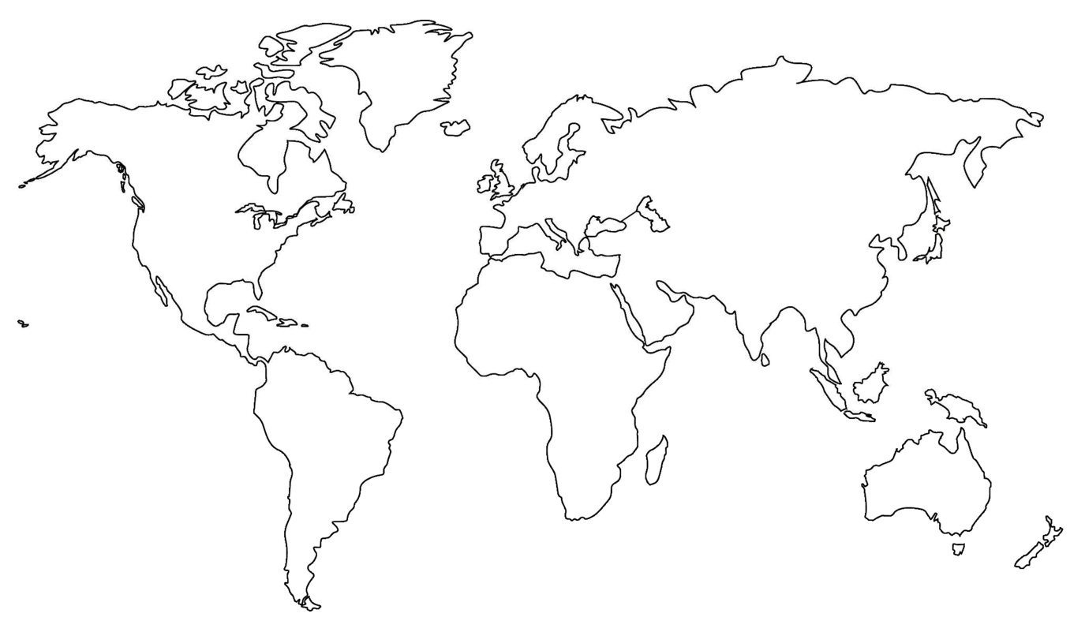

Where are you located?
Stamp Tool
Notes:
Length: 2 minutes for this slide
This slide is a quick demo/practice of the “Stamp” tool and how to use it during course interactions.
Have students Check where they live.
If it’s a small class, have students type their name where they live.
Reach out to the farthest away student

Slide 4


Developer
Patterns & Practices
aka.ms/OfficeDevPnP
aka.ms/OfficeDevPnPYammer

Slide 5
Statistics– Key numbers (previous month)
Forked 190 times (135)
236 merged pull requests (189)
58 closed issues (43)
More than 3050 (2160) unique visitors during last 2 weeks
Yammer group has 1419 members (757)
aka.ms/OfficeDevPnPYammer

Slide 6
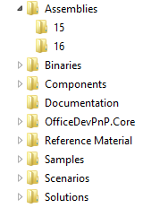
PnP Structure – folders and code
All referenced assemblies are included in package.
Contains latest 15 & 16 versions of the CSOM components.
No need for additional downloads
Reusable components targeted for reuse as such in projects.
Various Presentations on different scenarios.
Reusable remote operation component with extensions methods to standard CSOM objects.
Sample projects. Independent samples demonstrating a capability or functionality.
Scenario demonstrations for the usage of the core component. Contains additional explanations and usage models for API patterns.
Complex reusable solutions demonstrating combining multiple capabilities for building real solution. Uses core component.

Slide 7

Thank you for your assistance!
Erwin Van Hunen (Knowit AB) @erwinvanhunen
Henrik Gustafsson (HappySolutions) @SharePointHenke
Mark Wilson @PlanetWilson
Massimo Prota @massimoprota
Paolo Pialorsi (PiaSys.com) @PaoloPia
Vardhaman Deshpande (Content and Code) @vrdmn
Zane Rahui
Daniel Budimer (Microsoft)
Core team – Frank Marasco, Bert Jansen, Vesa Juvonen, Brian Michely, Suman Chakrabarti, Steve Walker

Slide 8
New and updated contributions
Core.Throttling(Vesa Juvonen)
Workflow.Activities (Paolo Pialorsi, PiaSys.com)
Workflow.CustomTasks (Paolo Pialorsi, PiaSys.com)
UserProfile.Manipulation.CSOM.Console (Vardhaman Deshpande, Content and Code)
Updates
PnP Core (Erwin, Suman, Bert, Sly, Henrik)
Core.JavaScriptInjection
Core.MMSSync (Bert Jansen)
PowerShell.Commands (Erwin Van Hunen, Knowit AB)

Slide 9
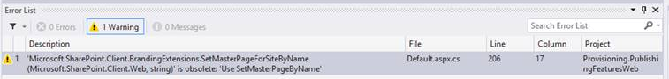
Updates to PnP Core and miscellaneous
Lots of refactoring, updates and improvements done and more to be introduced later
No breaking changes with any updates like in the past, just guidance in VS to drive to right direction
Old methods do work as well, but we indicate changes with obsolete messages
Improvements in unit tests ➔ 133 unit tests available!

Slide 10
New monthly schedule
New schedule starting from January 2015
Master merge first Friday of the month
Monthly call on 2nd Tuesday on each month

Slide 11
How to contribute?
Documentation in wiki
https://github.com/OfficeDev/PnP/wiki/contributing-to-Office-365-developer-patterns-and-practices
Simple steps
Fork
Apply changes and contributions
Submit a pull request
Core team members will review
Merged to Dev

Slide 12
MVA – Transform to app model
Transform SharePoint Customizations to SharePoint App Model live delivery on 11th of Dec
Will be available as recorded session around 5th of Jan
Based on PnP guidance
We are also working on more broad training based on similar topics
Modules
Introduction to App Model Transition Tasks
Controlling Branding in SharePoint Using App Model
Site Collection and Site Provisioning with App Model
UX Components and Site Modifications Using Apps Techniques
User Profile and Personalization with App Model
Practices for ​Converting Existing Sites to App Model Functionality

Slide 13
CSOM – latest updates in Nov and Dec CU
List
New public property Microsoft.SharePoint.Client.List.MajorVersionLimit
New public property Microsoft.SharePoint.Client.List.MajorWithMinorVersionsLimit
Site
New public method Microsoft.SharePoint.Client.Web.AddSupportedUILanguage()
New public method Microsoft.SharePoint.Client.Web.RemoveSupportedUILanguage()
New setter for public property Microsoft.SharePoint.Client.RegionalSettings.LocaleId
New public method Microsoft.SharePoint.Client.RegionalSettings.Update()
Site Collection
New public property Microsoft.SharePoint.Client.Site.Audit
New public property Microsoft.SharePoint.Client.Site.AuditLogTrimmingRetention
New public property Microsoft.SharePoint.Client.Site.TrimAuditLog
New Class Microsoft.SharePoint.Client.Audit
New Enum Microsoft.SharePoint.Client.AuditMaskType
New Class Microsoft.SharePoint.Client.AuditPropertyNames
New public property Microsoft.SharePoint.Client.Site.SecondaryContact

Slide 14

Roadmap – What’s coming?
Starter kits
Provisioning
Remote timer jobs
Improvements to core component
Unit testing, logging, other stuff
Guidance
Application Life Cycle for app model
Design patterns for App model based implementation
Transformation guidance for existing customizations
App model impact for enterprise architecture
Content migration for app model implementation
Continuous integration

Slide 15
Feedback…
Please keep the feedback coming in Yammer… we need your input for the prioritization.
Notes:
Priority on planned topics
More code samples
Add core component capabilities
Reusable presentation material
Documentation on patterns and practices for app model (ALM ec.)
More complex solutions
More Office Client apps
More JavaScript app
Length: 30 second for this slide
Instructor notes
The following slides will walk you though the Lync tools that we will use in this class.
You will use all of these tools later in the class
Stress that your students will be able to run much more engaging meetings if they use these tools in their own Lync Meetings.
Course Development Notes:

Slide 16
Transform your code Providing App Model Patterns for common Full Trust Code scenarios
100+ Visual Studio projects Common scenarios
Branding
Site provisioning
Remote event receivers
Large file support
Taxonomy driven navigation
And much more…
Contribute
This is open source project and open for contirbutions
Developer
Patterns & Practices
aka.ms/OfficeDevPnP

Slide 17

Questions?

Slide 18


© 2014 Microsoft Corporation. All rights reserved. Microsoft, Windows, and other product names are or may be registered trademarks and/or trademarks in the U.S. and/or other countries.
The information herein is for informational purposes only and represents the current view of Microsoft Corporation as of the date of this presentation. Because Microsoft must respond to changing market conditions, it should not be interpreted to be a commitment on the part of Microsoft, and Microsoft cannot guarantee the accuracy of any information provided after the date of this presentation. MICROSOFT MAKES NO WARRANTIES, EXPRESS, IMPLIED OR STATUTORY, AS TO THE INFORMATION IN THIS PRESENTATION.

